Slide 1
Overview of New Matrix and GIS Functionality
in Locust Migration Application
April 2021
Sonny Zinn and Mark Cohen

Slide 2
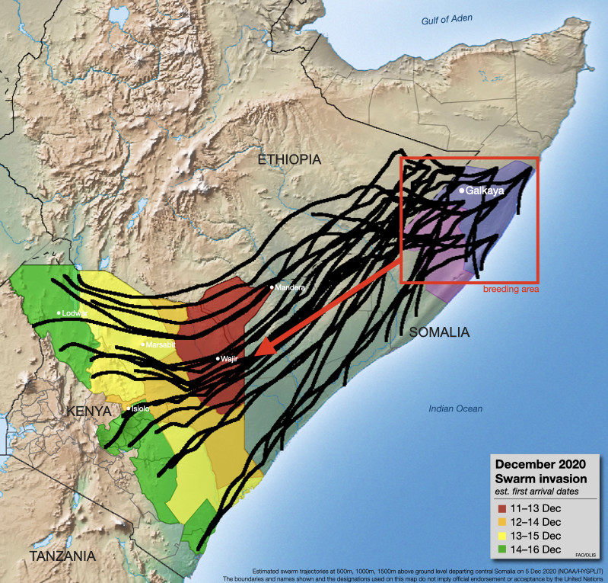
Locust Migration Tool: Summary
HYSPLIT used, but daily takeoffs & landings difficult to implement
New locust functionality stops trajectory each day; starts next day
web application –> users not required to download met data
Modes: single swarm → batch → matrix → API
User Inputs: start location and time; met data; number of days; flying height(s); graphics options; output options
Outputs: trajectory endpoints, graphics, shapefiles, HYSPLIT files
Primary Partner:
UN FAO’s Chief Locust Forecaster Keith Cressman and his team
his knowledge of locust behavior has been critical
Other partners: e.g., Plant Village (Penn State University)
From Keith Cressman, UN FAO
2
Notes:
As you can imagine, there are number of uncertainties, in addition to uncertainties in the weather forecast.
What influences swarm decision if/when to take off on a given day?
What influences swarm decision regarding flying height? Do they stay at the same height or does it vary during the day’s flight? You can see in the figure at right, with flying heights at 500, 1000, and 1500 meters above the ground, that the locust's migration path will depend on what height they fly at. But we don’t generally know the exact height, or why they might pick one height or another.
What influences the swarm’s decision to land?
make application aware of current land-use characteristics
incorporate up-to-date land-use characteristics from satellites
As with all models, evaluation and improvement efforts can reduce uncertainties. We are looking for partners to work with us to:
Assemble data regarding timing and location of swarm take-offs and landings
Collect data regarding swarm flying heights
Compare against model predictions
Incorporate appropriate biological factors into model

Slide 3
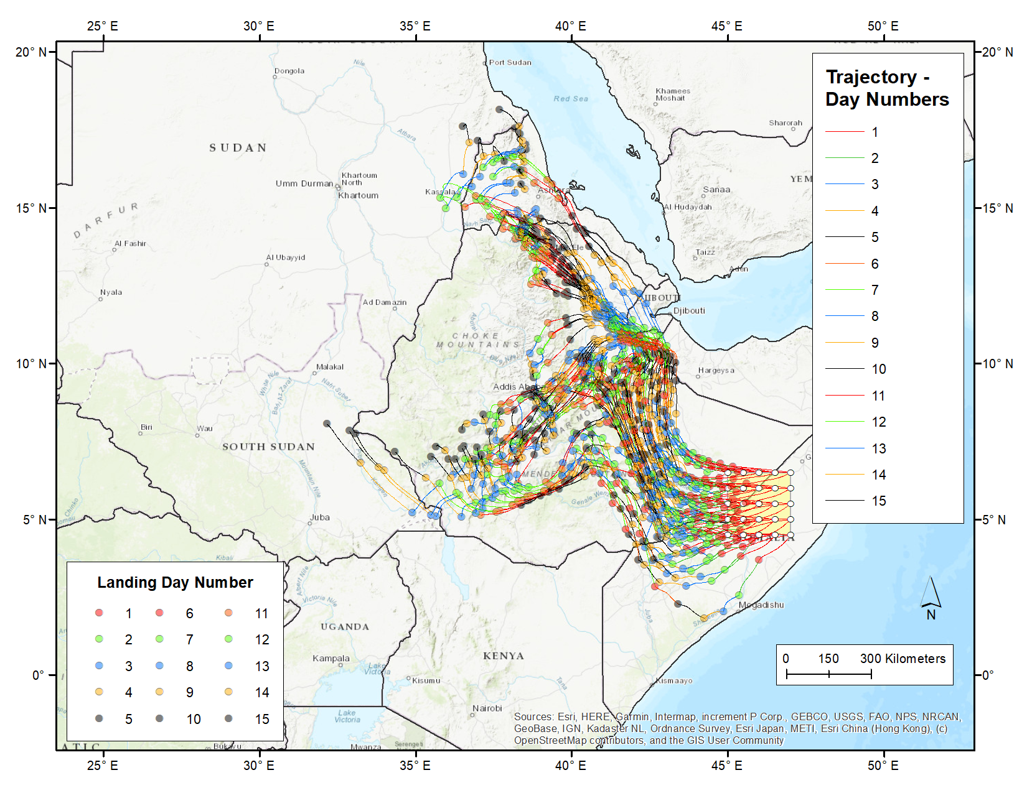
Locust Migration Tool: New Matrix and GIS Features
Matrix functionality allows user to specify a grid of swarm source locations; simulations carried out for each source location in grid.
Lower left corner latitude and longitude specified
Grid spacing and number of grid points specified in each direction
New Outputs:
Trajectories
Trajectory Frequency
Time of Arrival
Daily Take-off and Landing Locations
GIS Shapefiles: extensive attributes now embedded so that more effective and efficient processing within GIS applications can be carried out
3
Notes:
As you can imagine, there are number of uncertainties, in addition to uncertainties in the weather forecast.
What influences swarm decision if/when to take off on a given day?
What influences swarm decision regarding flying height? Do they stay at the same height or does it vary during the day’s flight? You can see in the figure at right, with flying heights at 500, 1000, and 1500 meters above the ground, that the locust's migration path will depend on what height they fly at. But we don’t generally know the exact height, or why they might pick one height or another.
What influences the swarm’s decision to land?
make application aware of current land-use characteristics
incorporate up-to-date land-use characteristics from satellites
As with all models, evaluation and improvement efforts can reduce uncertainties. We are looking for partners to work with us to:
Assemble data regarding timing and location of swarm take-offs and landings
Collect data regarding swarm flying heights
Compare against model predictions
Incorporate appropriate biological factors into model

Slide 4
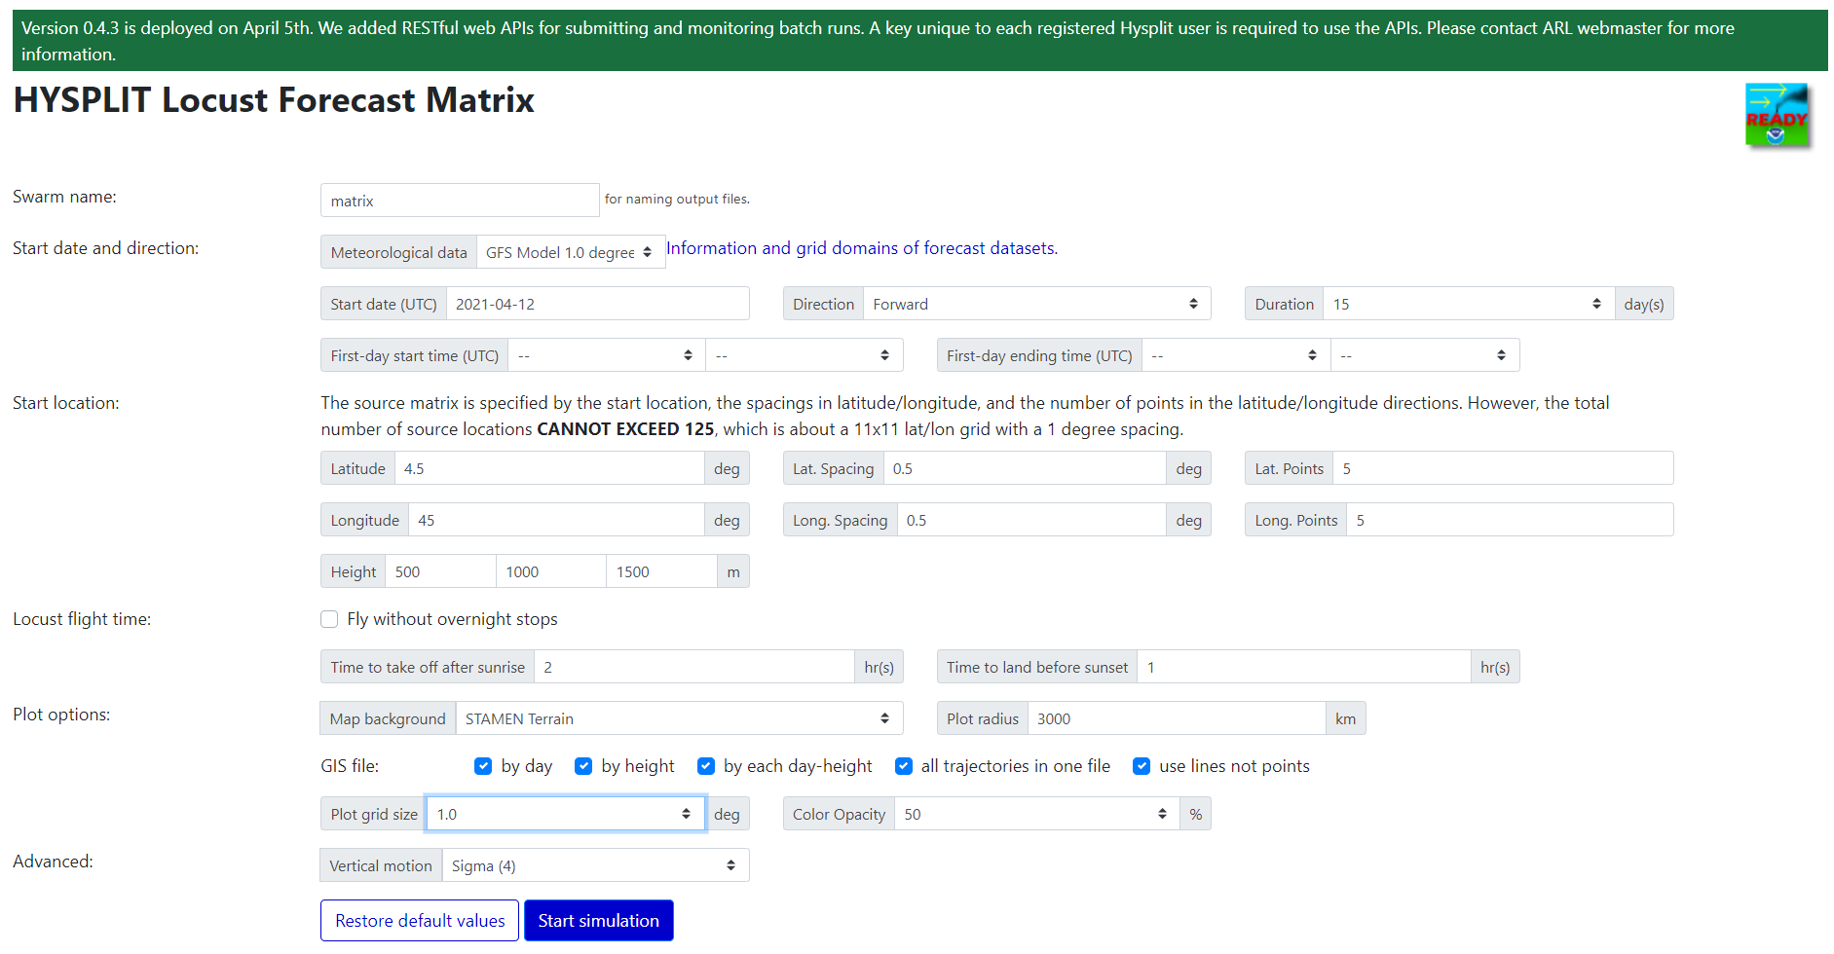
Matrix user-input screen – all of the single-swarm and batch functionality, plus additional input and output specifications
Lower left corner of source grid
Grid spacing
Number of grid points in each direction
Grid size for trajectory frequency statistics and graphics
GIS output options for trajectories

Slide 5
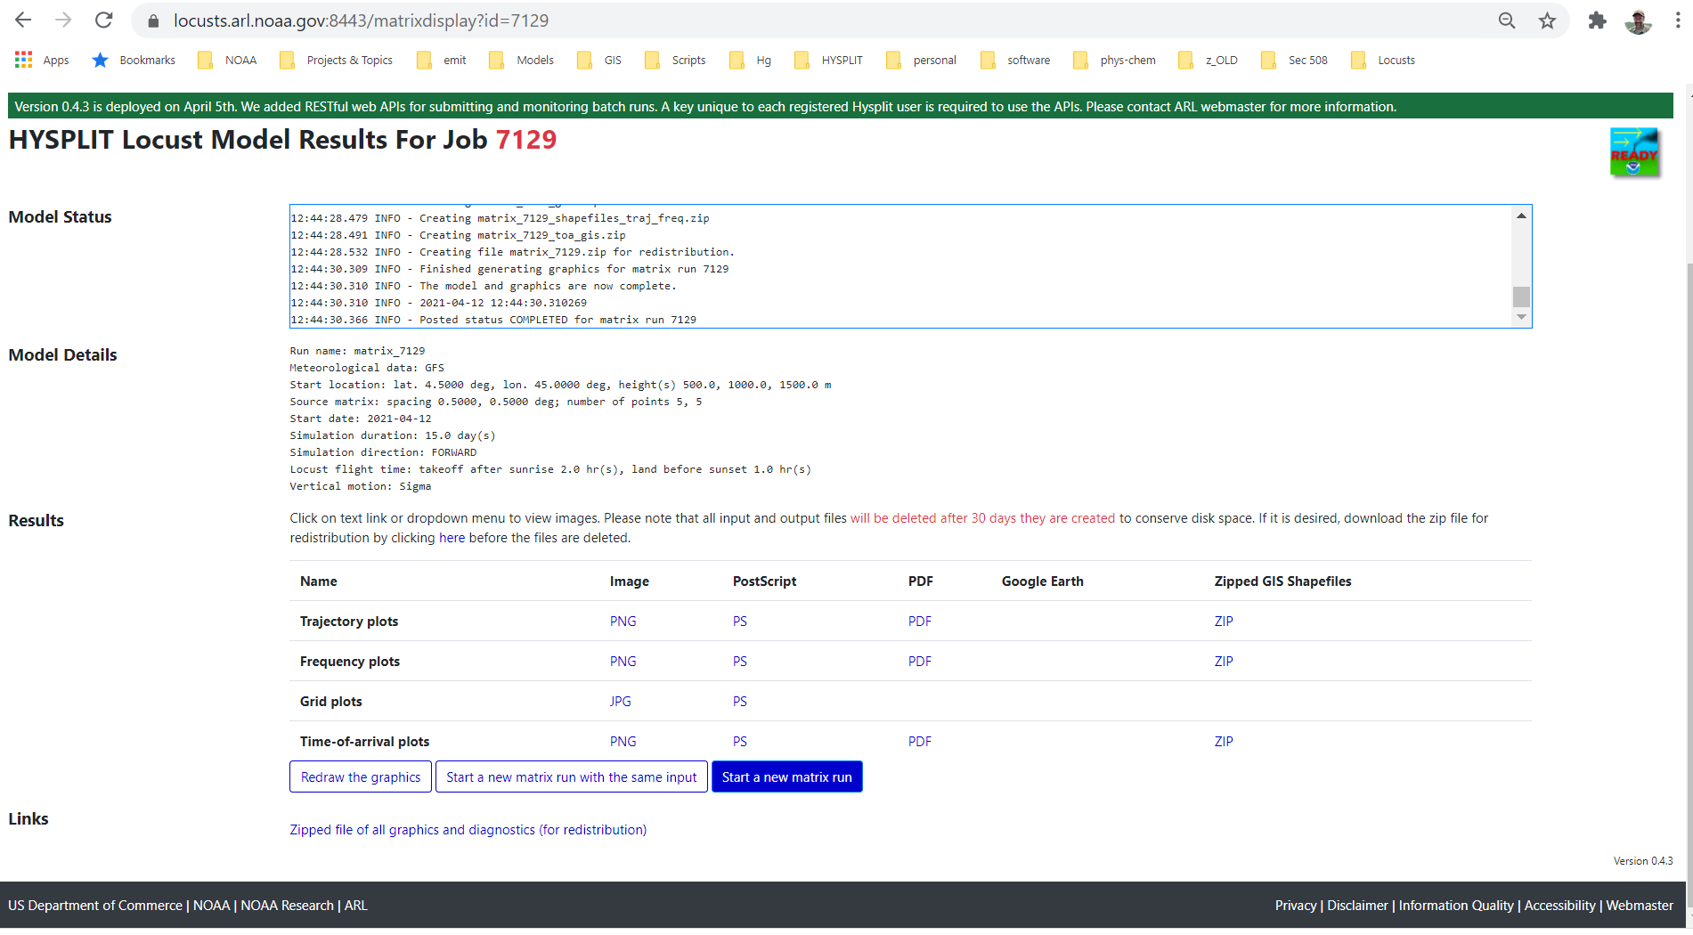
Run-time screen – showing view once run is complete
Run-time messages scroll during simulations
Run specification summary
Individual graphics and output collections
Zip file with all inputs and outputs

Slide 6
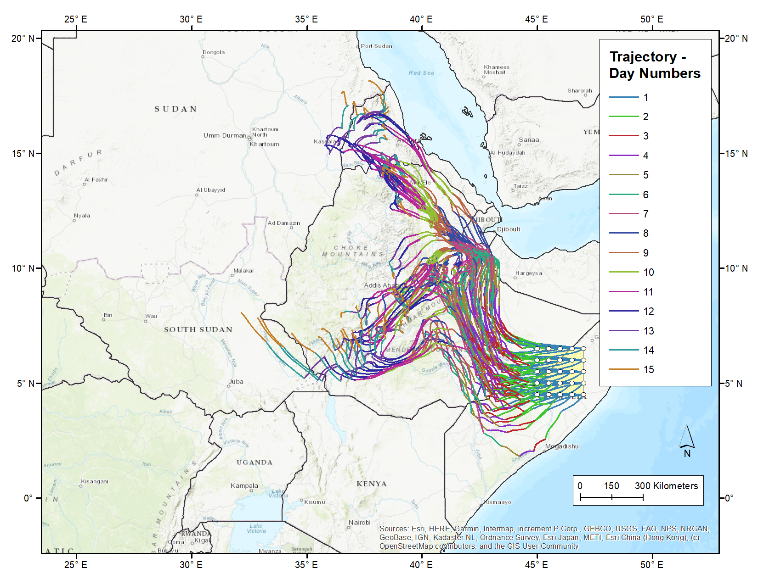
In this example, we had 5 grid points in “longitude” and 5 grid point in “latitude”, so there was a total of 25 source locations
And there were 3 heights chosen (500m, 1000m, and 1500m)
So, there were a total of 75 trajectory-based migration paths simulated.
And there were 15 days of simulation, so, each trajectory had 15 take-off locations and 15 landing locations.
So, there are a total of 1125 trajectory paths simulated in this example

Slide 7
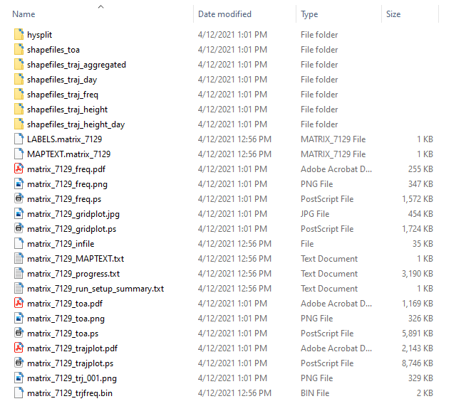
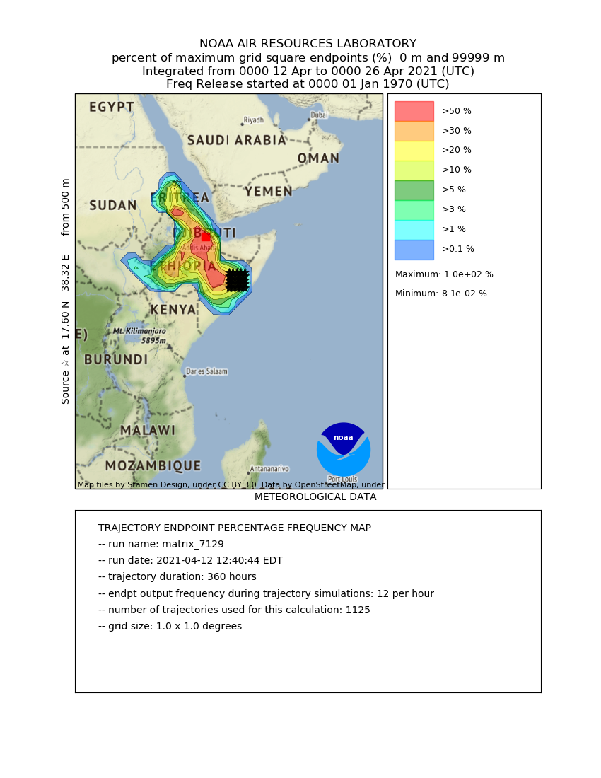
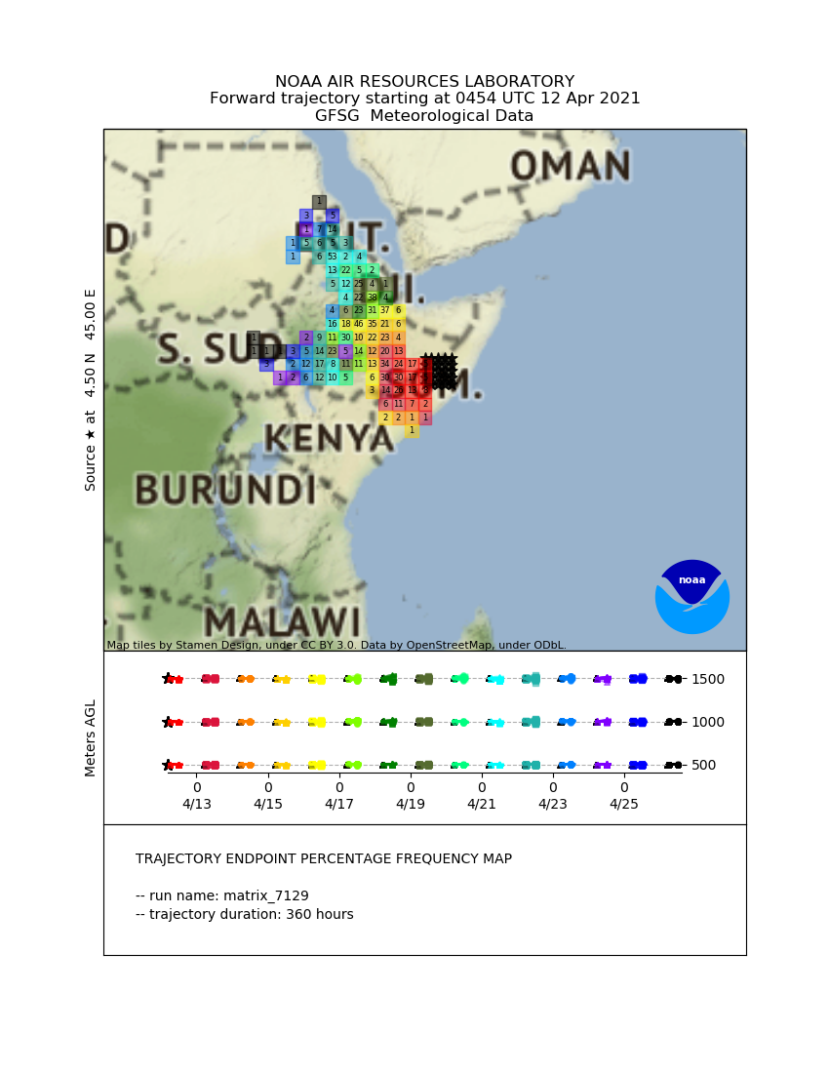
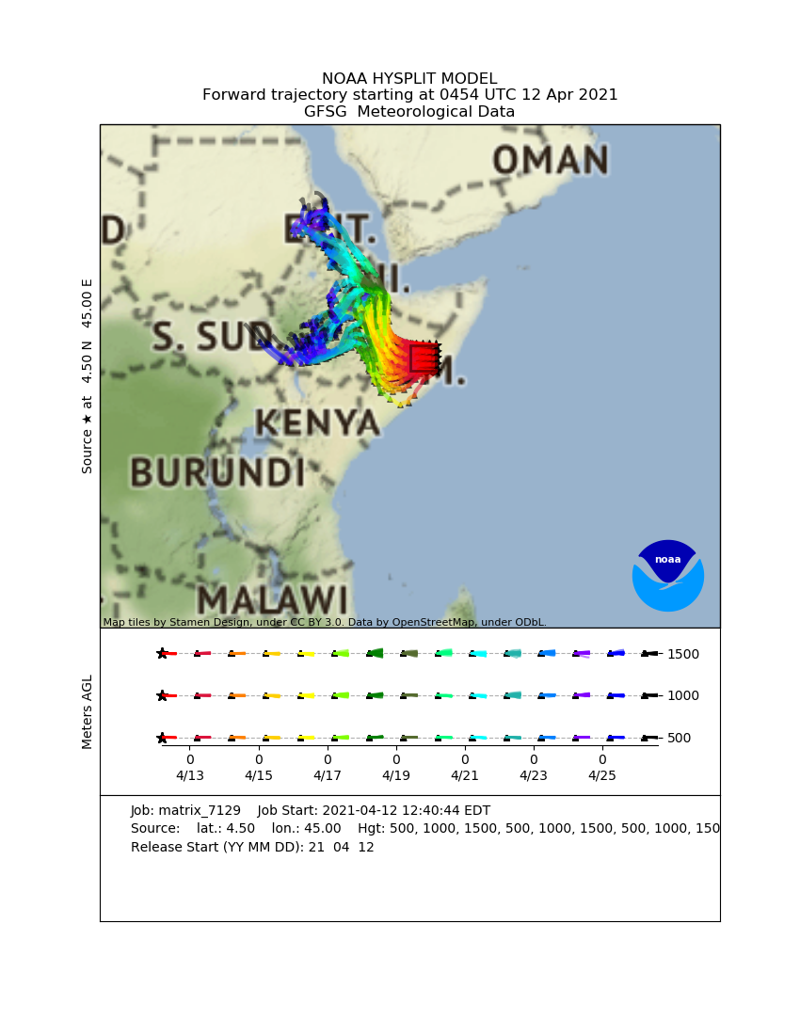
Files generated in this example, once zipped “redistribution” file is unzipped
Folder with HYSPLIT Control and other model-specific files.
Folders with shapefiles associated with time of arrival (toa), trajectories, and trajectory frequencies. These can be imported into GIS applications (e.g. ArcGIS) and displayed – and processed further – according to the user’s needs
Trajectory frequency graphics
Summary files of inputs and outputs
Trajectory frequency graphics via gridplot – a different HYSPLIT mapping program
Time of Arrival graphics
Trajectory graphics

Slide 8
Trajectories

Slide 9
Files generated in this example, once zipped “redistribution” file is unzipped
Folder with HYSPLIT Control and other model-specific files.
Folders with shapefiles associated with time of arrival (toa), trajectories, and trajectory frequencies. These can be imported into GIS applications (e.g. ArcGIS) and displayed – and processed further – according to the user’s needs
Trajectory frequency graphics
Summary files of inputs and outputs
Trajectory frequency graphics via gridplot – a different HYSPLIT mapping program
Time of Arrival graphics
Trajectory graphics

Slide 10
Graphic output of trajectories using basic HYSPLIT graphics
This is the output using basic HYSPLIT graphics.
Some settings can be configured in matrix user-specification screen, including:
Map background
Map radius
But for more advanced modifications, user can import shape files provided in output (see additional description of this functionality below)
The source locations are shown with a bounding box
In this output – example at left – each day’s trajectory is color-coded based on colors shown in bottom day-height panel of figure; and in this panel, you can also see the three flying heights chosen for this example

Slide 11
Trajectories Aggregated

Slide 12
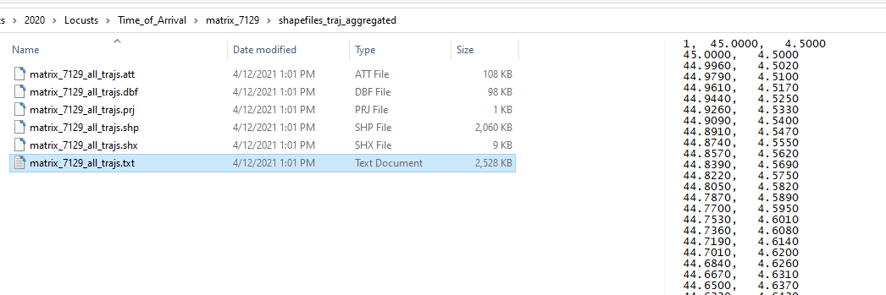
Folder: shapefiles_traj_aggregated
Has a shapefile – in this example: matrix_7129_all_trajs.shp -- that can be imported into GIS applications. This shapefile has all of the trajectories in the analysis. Each trajectory has numerous identifying characteristics, however, and so, the user can select and display – or not display – trajectories based on their characteristics.

Slide 13
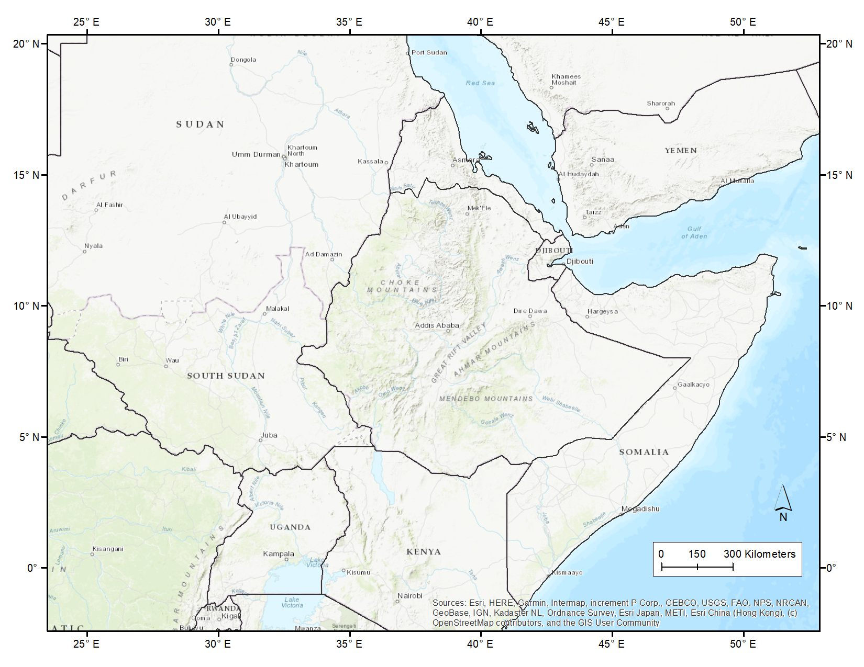
GIS Processing: Base Map
Here is a base map before any of the locust app shapefiles have been added.

Slide 14
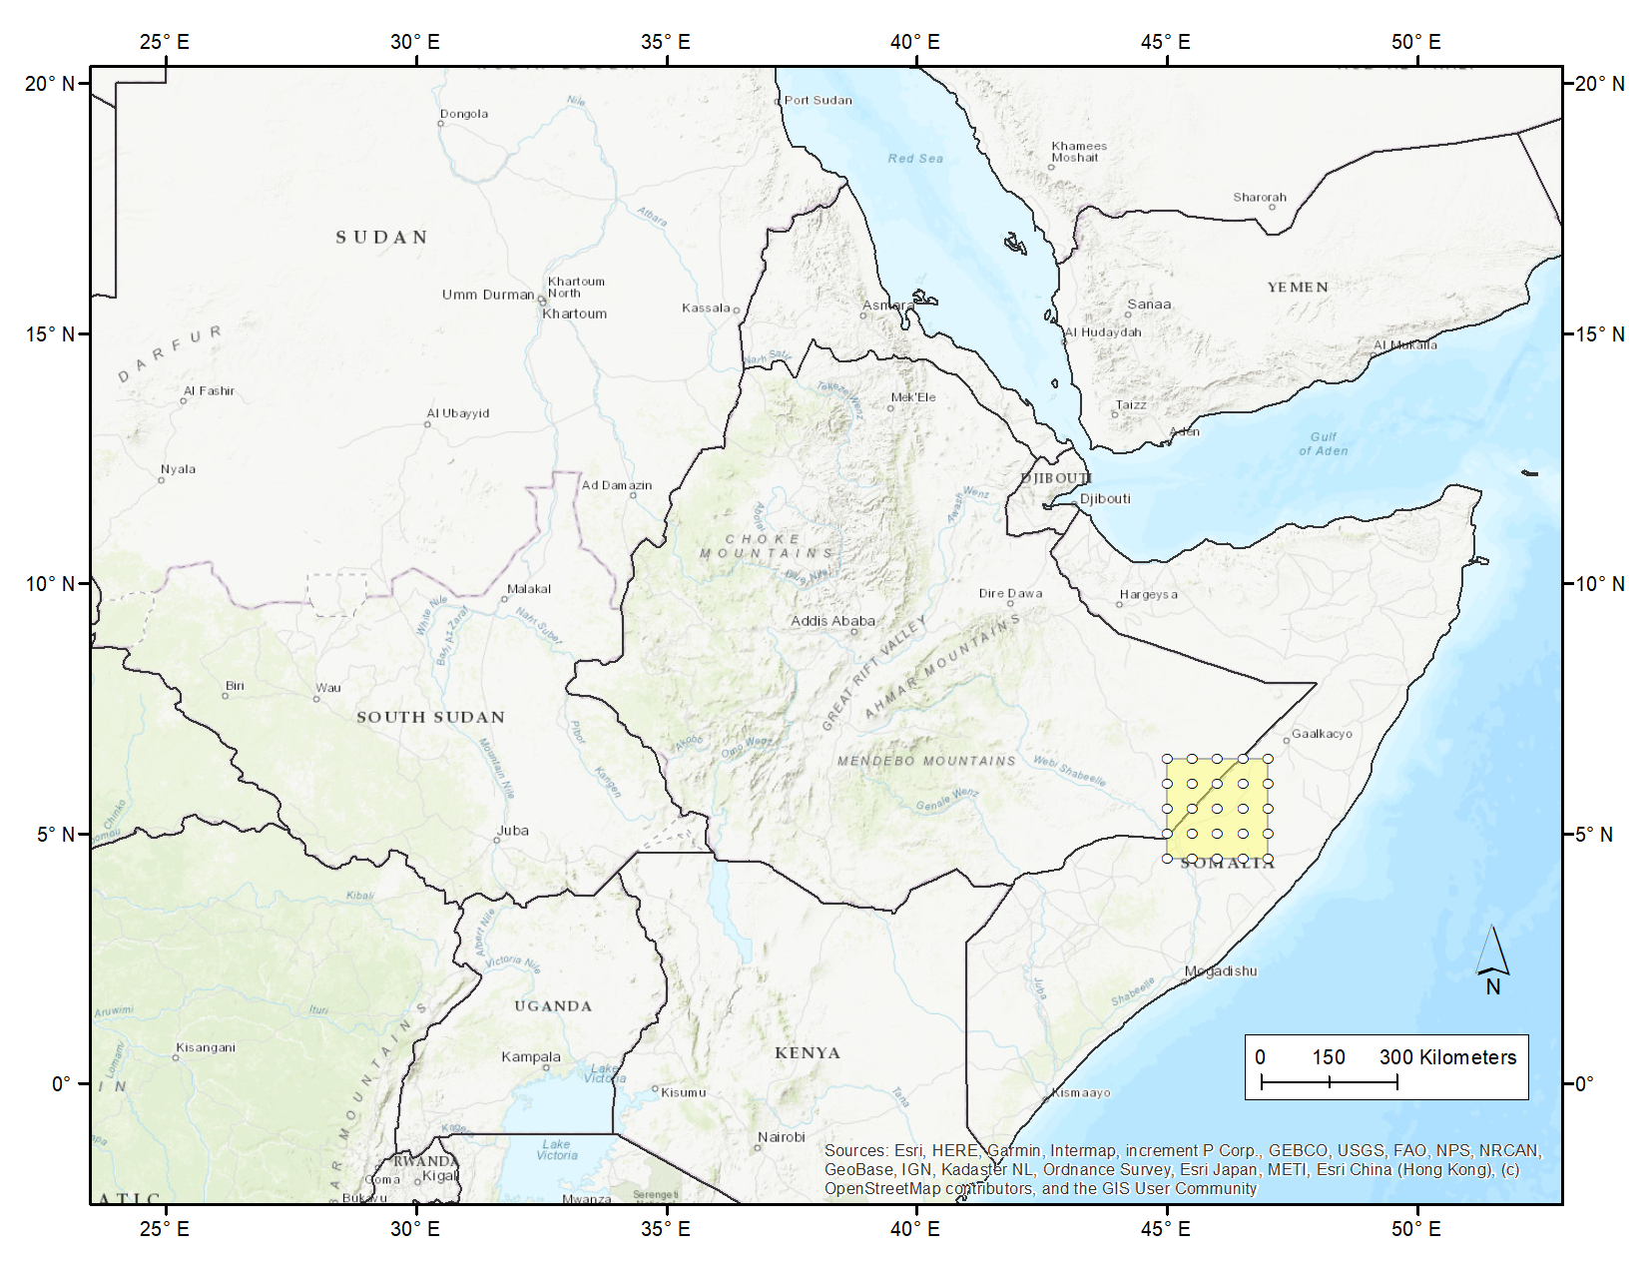
GIS Processing: Source matrix
Two analogous source matrix shapefiles have been added from a different directory (shapefiles_toa):
shapefiles_toa\matrix_7129_src_bbox.shp
a bounding box that encompasses the entire source matrix
shapefiles_toa\matrix_7129_src_locs.shp
a set of points – one for each source point in the source matrix defined for the matrix simulation that has been conducted

Slide 15
GIS Processing:
Aggregated Trajectories
A shapefile that contains all of the trajectories has been added:
shapefiles_traj_aggregated\matrix_7129_all_trajs.shp
In this example, the trajectories segments have been colored using the daynum field to show the trajectories based on “day”
The next slide shows all of the fields available in the shapefile to select or classify the trajectories

Slide 16
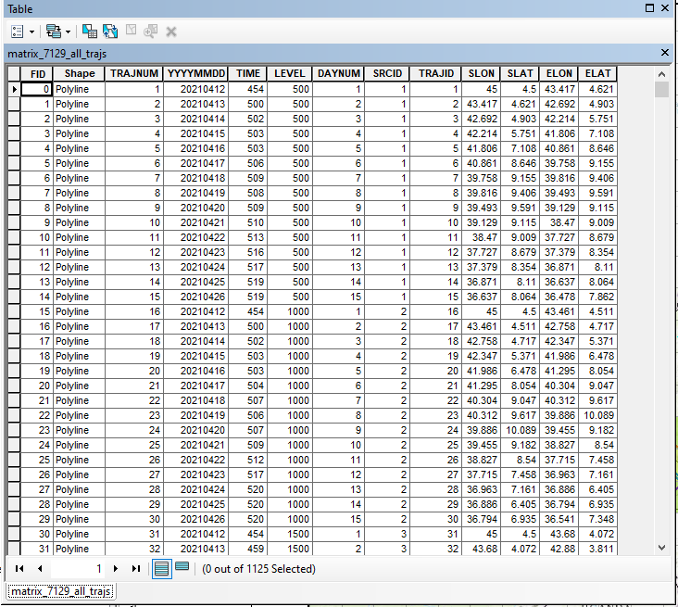
GIS Processing: Aggregated Trajectories
Here are all of the attributes that are associated with each trajectory in the aggregated trajectory shapefile:
TRAJNUM: unique number for each trajectory for each day for each height – in this example, goes from 1 to 1125
YYYYMMDD: date of the trajectory
TIME: UTC start time of the trajectory
LEVEL: starting height (m-agl) – in this example, starting heights of 500, 1000, and 1500 meters above ground level were used
DAYNUM: day number – in this example, this goes from 1-15
SRCID: a unique number for each source location and height combination. In this example, there are 25 source locations and 3 heights, and so, the SRCID numbers go from 1 to 75. If one wants to remove a trajectory from the display, e.g., because it is deemed an unlikely path, such as a path going out over the ocean, then one can simply remove that overall migration path (all 15 days) by removing that SRCID from the display. Or if desired, one can remove just part of that path by further considering DAYNUM in the selection / de-selection of items to display
TRAJID: This is the same as TRAJNUM, and in this example, goes from 1 to 1125
SLON: Starting longitude for the trajectory
SLAT: Starting latitude for the trajectory
ELON: Ending longitude for the trajectory
ELAT: Ending latitude for the trajectory

Slide 17
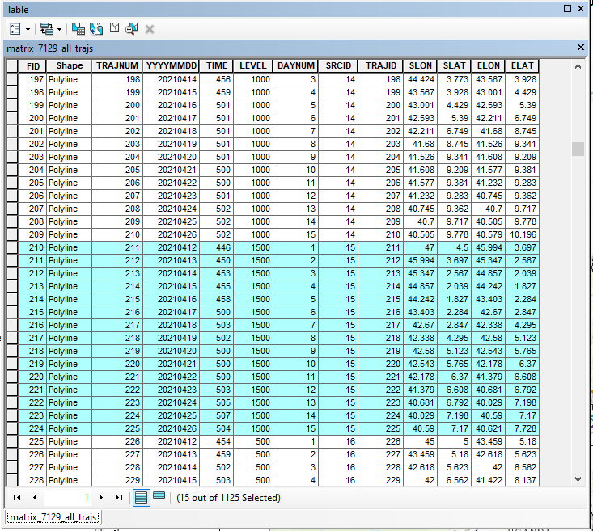
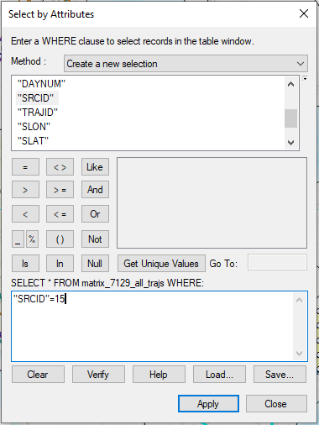
GIS Processing: Selecting a specific SRCID (in ArcGIS)
Here is an example of selecting a specific SRCID – I.e., a specific starting location and height – in ArcGIS, a GIS application. There are 15 trajectory segments, one for each day, associated with this particular SRCID

Slide 18
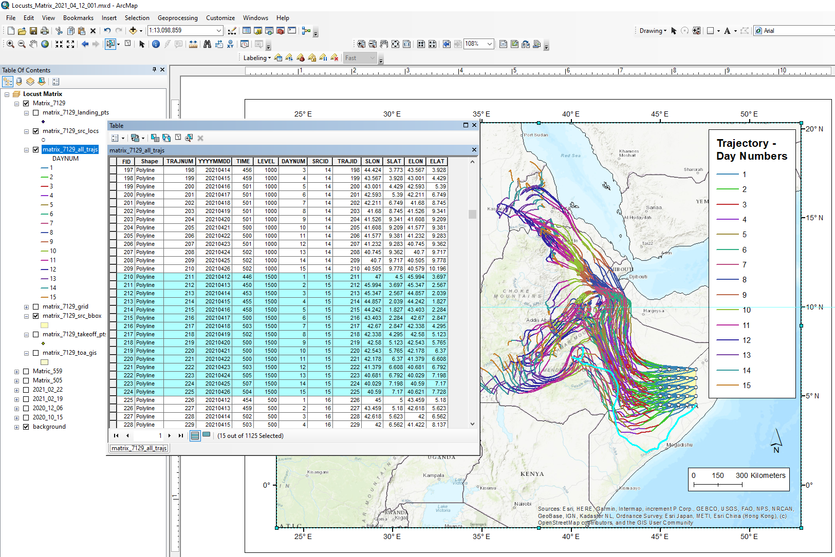
GIS Processing: Selecting a specific SRCID (in ArcGIS)
Here is an example of selecting a specific SRCID – I.e., a specific starting location and height – in ArcGIS, a GIS application. In this slide, you can see the entire selected trajectory outlined in light blue

Slide 19
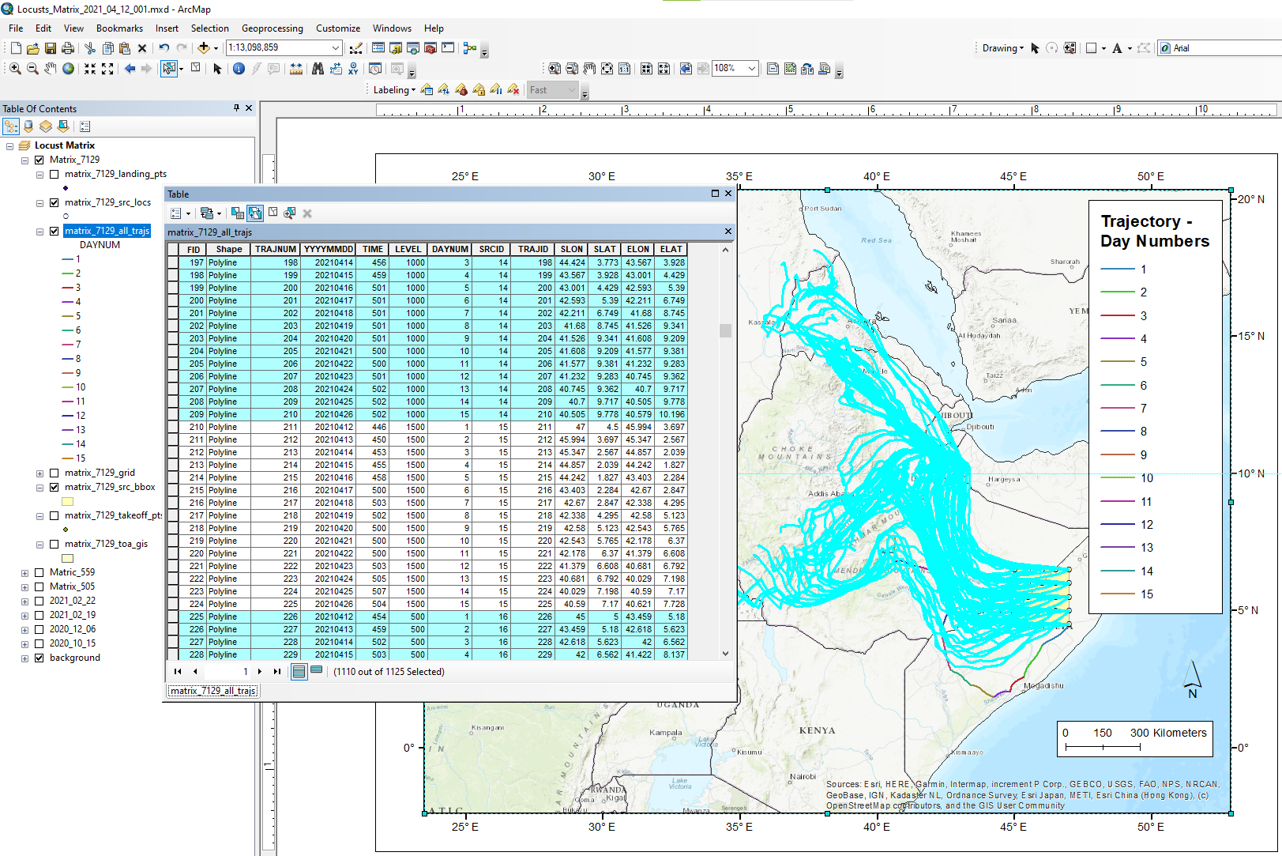
GIS Processing: Selecting a specific SRCID (in ArcGIS)
Here we have inverted the selection, to select all trajectories other than SRCID = 15. This is an example of what one might do to “remove” a given trajectory from the display, i.e., selecting all trajectories other than that one, and saving the resulting collection to a new shapefile.

Slide 20

GIS Processing: Selecting a specific SRCID (in ArcGIS)
Here is the collection of trajectories without the trajectory associated with SRCID = 15.

Slide 21
Time of Arrival

Slide 22
Files generated in this example, once zipped “redistribution” file is unzipped
Folder with HYSPLIT Control and other model-specific files.
Folders with shapefiles associated with time of arrival (toa), trajectories, and trajectory frequencies. These can be imported into GIS applications (e.g. ArcGIS) and displayed – and processed further – according to the user’s needs
Trajectory frequency graphics
Summary files of inputs and outputs
Trajectory frequency graphics via gridplot – a different HYSPLIT mapping program
Time of Arrival graphics
Trajectory graphics

Slide 23
Graphic output of time-of-arrival information using basic HYSPLIT graphics
This is generated by the App. For more advanced modifications, user can import shape files provided in output (see additional description of this functionality below)
The source locations are shown with a matrix of stars
The grid squares are color-coded with the same colors as the trajectories, and the color-coding is shown in the bottom panel of the figure for each day.
And in the grid squares are the number of trajectory landing points. The color chosen for the grid square corresponds to the “day” with the most associated landing points in that grid square.
There are 1125 landing points in this example, and the sum of all of the numbers displayed in this graphic add up to 1125

Slide 24
Time of Arrival:
Daily Landing Points

Slide 25
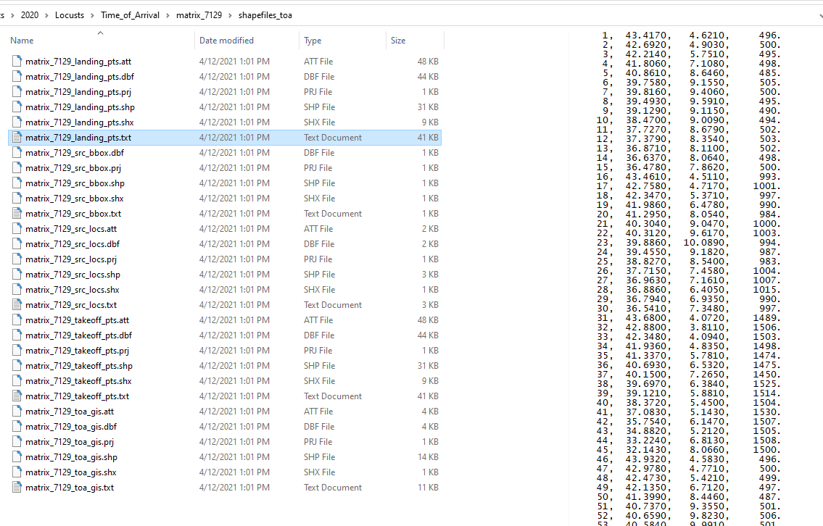

Slide 26
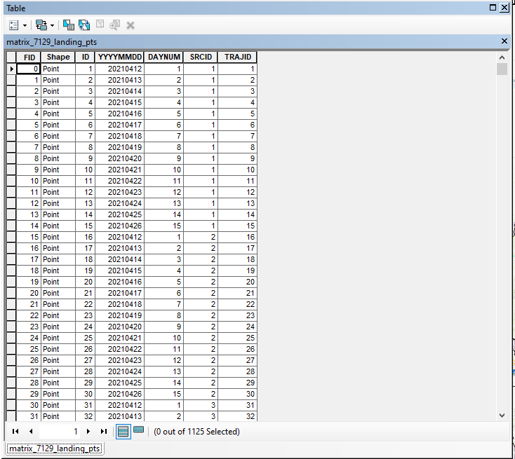
GIS Processing: Daily Landing Points
Here are the key attributes that are associated with the daily landing points shapefile in the shapefiles_toa subdirectory:
TRAJID: unique number for each trajectory for each day for each height – in this example, goes from 1 to 1125 (same as TRAJNUM in trajectory attributes)
YYYYMMDD: date of the trajectory
DAYNUM: day number – in this example, this goes from 1-15
SRCID: a unique number for each source location and height combination. In this example, there are 25 source locations and 3 heights, and so, the SRCID numbers go from 1 to 75. If one wants to remove a landing point of trajectory from the display, e.g., because it is deemed an unlikely path, such as a path going out over the ocean, then one can simply remove that overall migration path (all 15 days) by removing that SRCID from the display. Or if desired, one can remove just part of that path by further considering DAYNUM in the selection / de-selection of items to display

Slide 27
GIS Processing: Selecting / displaying landing points for a certain set of forecast days (in ArcGIS)
Here are all of the landing points and trajectories for this example. We will select and display subsets of this complete set in the following slides

Slide 28
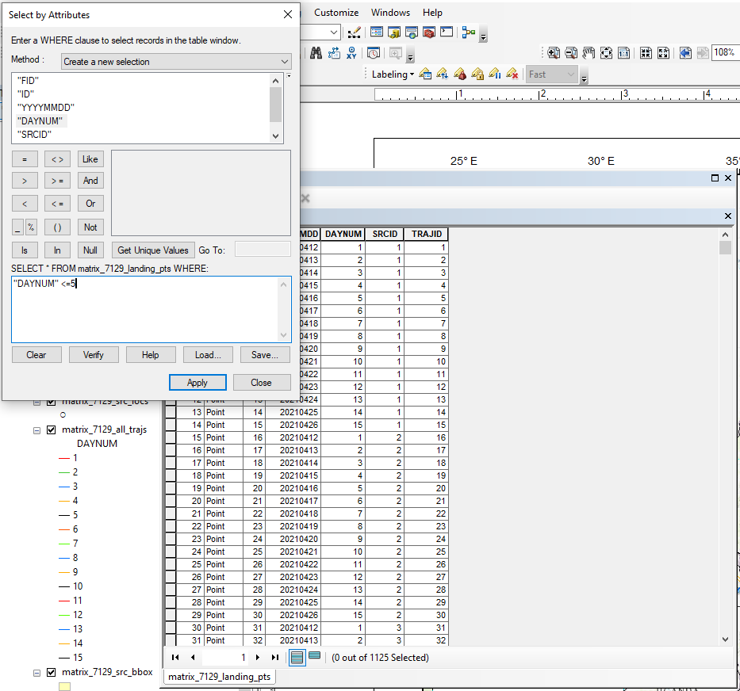
GIS Processing: Selecting / displaying landing points for a certain set of forecast days (in ArcGIS)
Process for selecting landing points for days 1 through 5

Slide 29
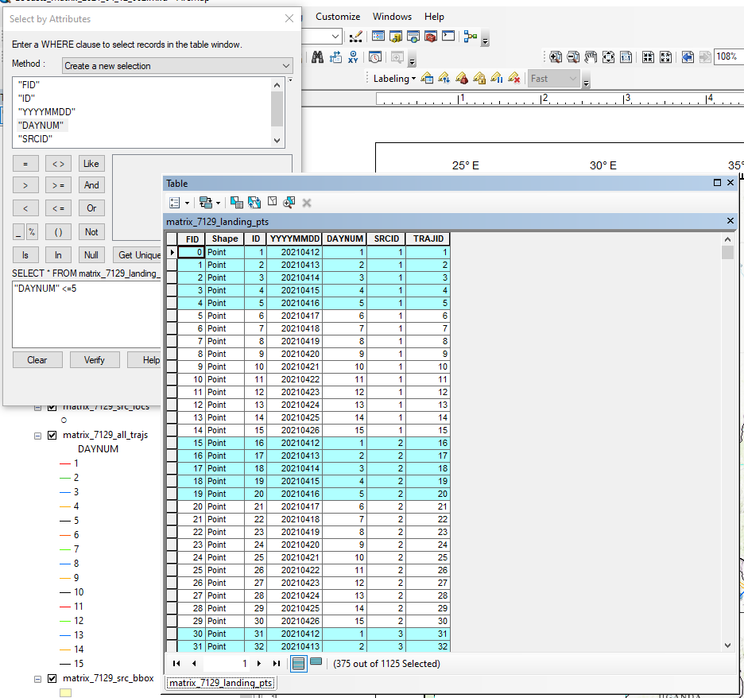
GIS Processing: Selecting / displaying landing points for a certain set of forecast days (in ArcGIS)
Process for selecting landing points for days 1 through 5

Slide 30
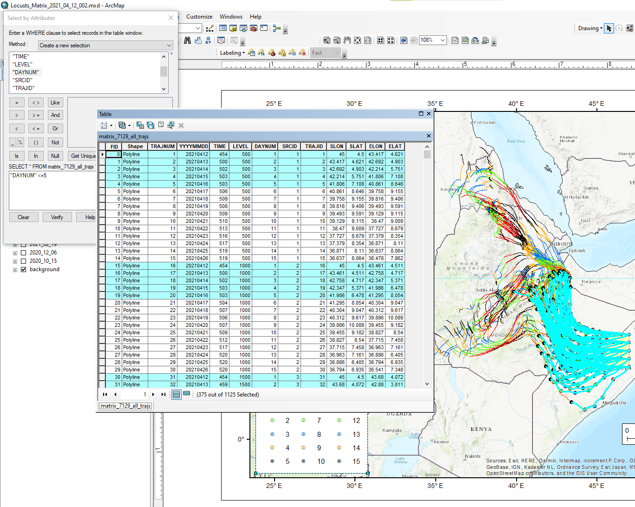
GIS Processing: Selecting / displaying landing points for a certain set of forecast days (in ArcGIS)
Process for selecting trajectories for days 1 through 5

Slide 31
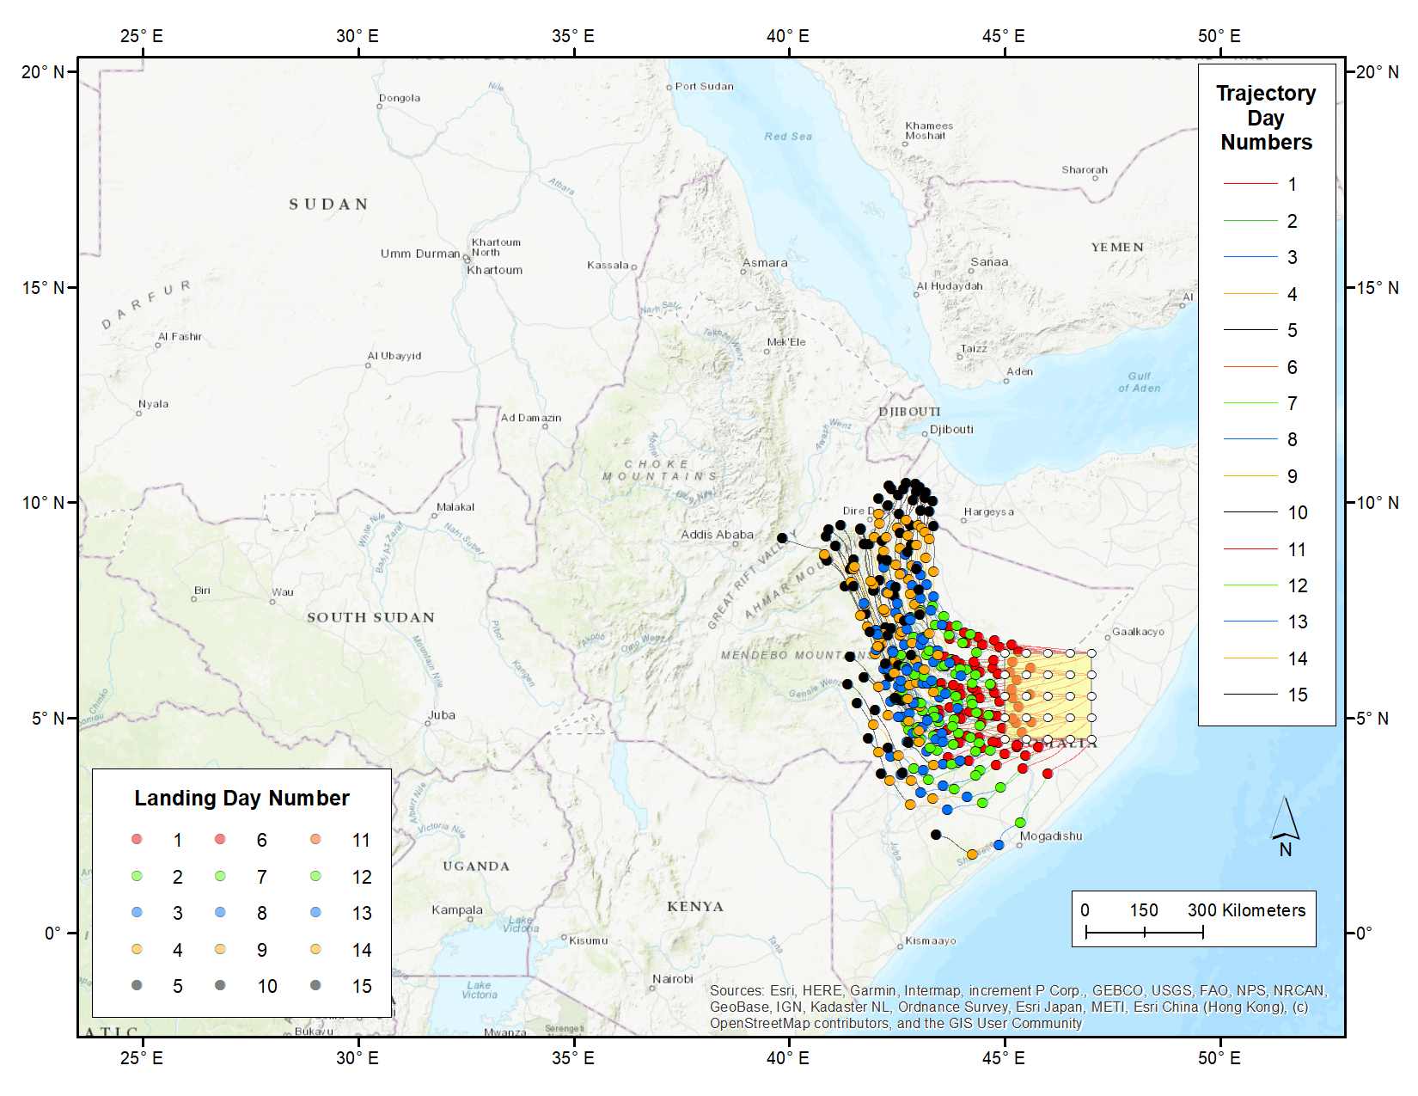
GIS Processing: Selecting / displaying landing points for a certain set of forecast days (in ArcGIS)
Here is the collection of landing points and associated trajectories for days 1 through 5.

Slide 32
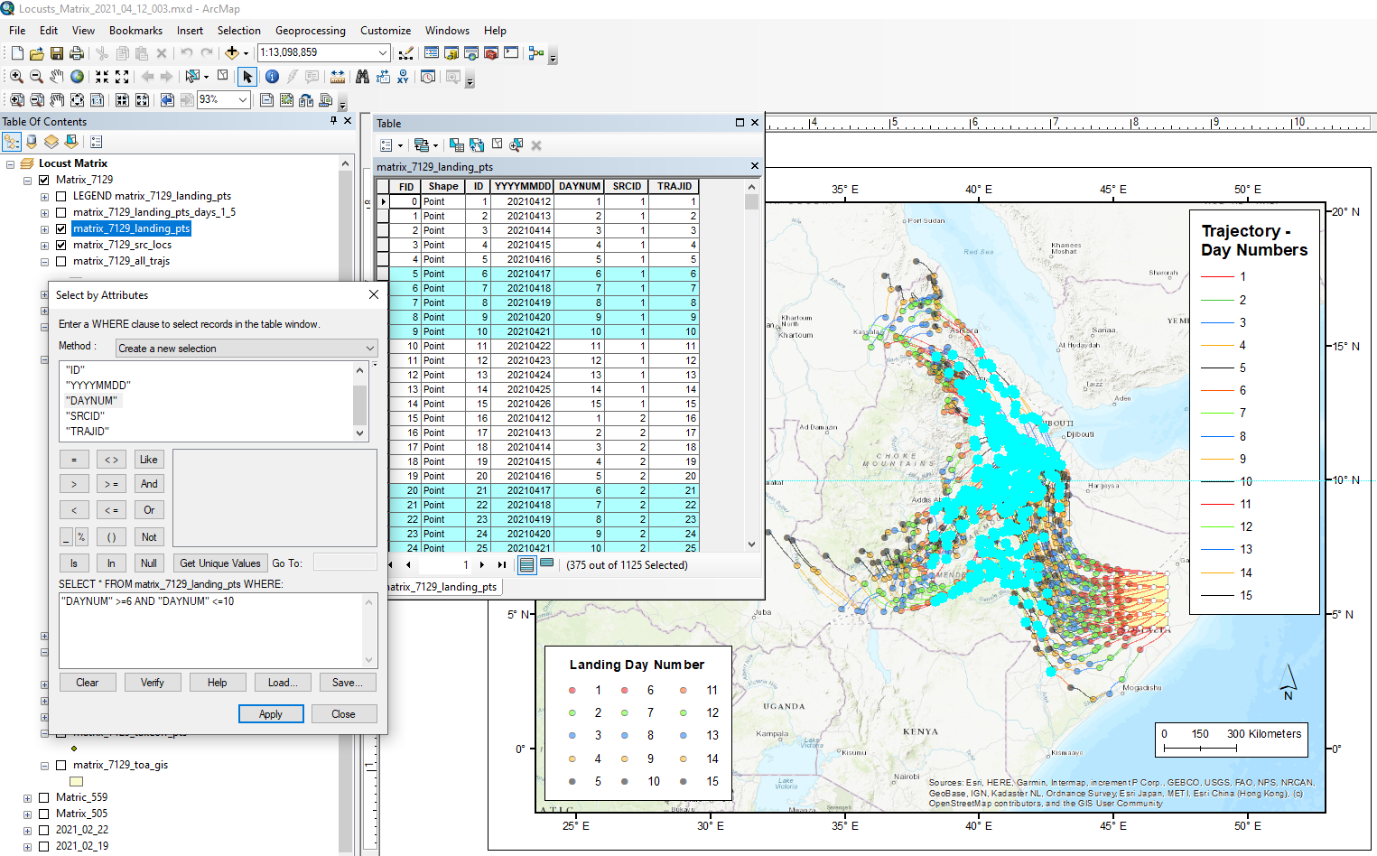
GIS Processing: Selecting / displaying landing points for a certain set of forecast days (in ArcGIS)
Here is the selection procedure to select landing points for days 6 through 10

Slide 33
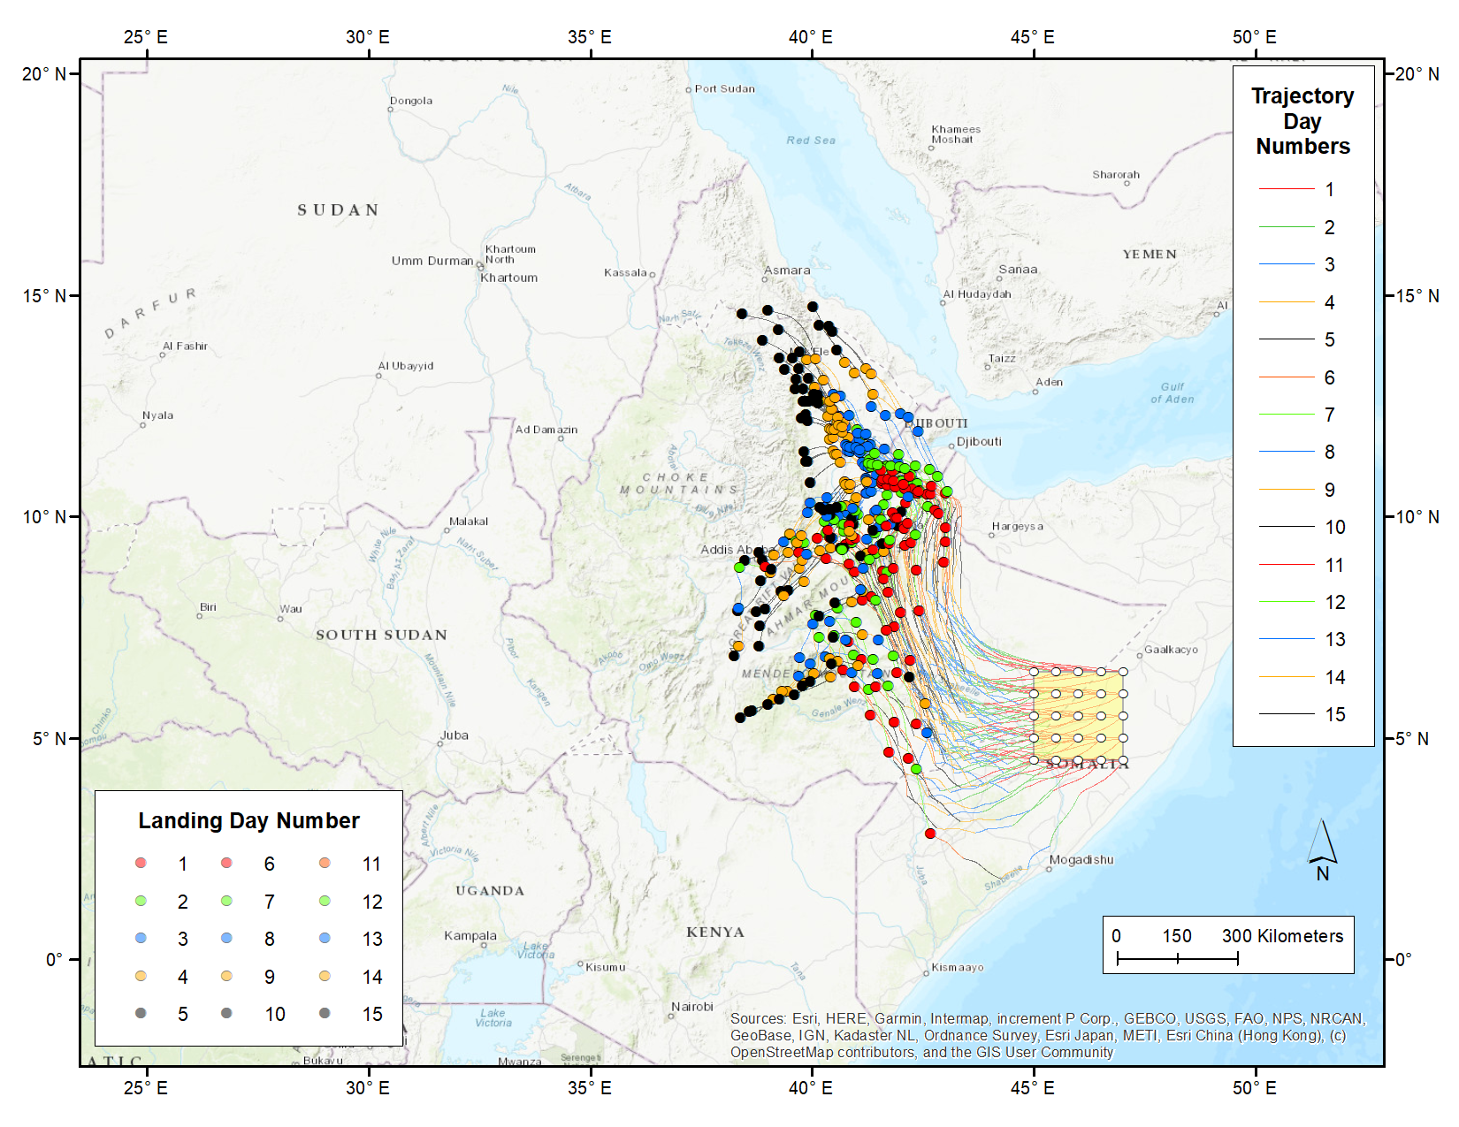
GIS Processing: Selecting / displaying landing points for a certain set of forecast days (in ArcGIS)
Here is the collection of landing points and associated trajectories for days 6 through 10.

Slide 34
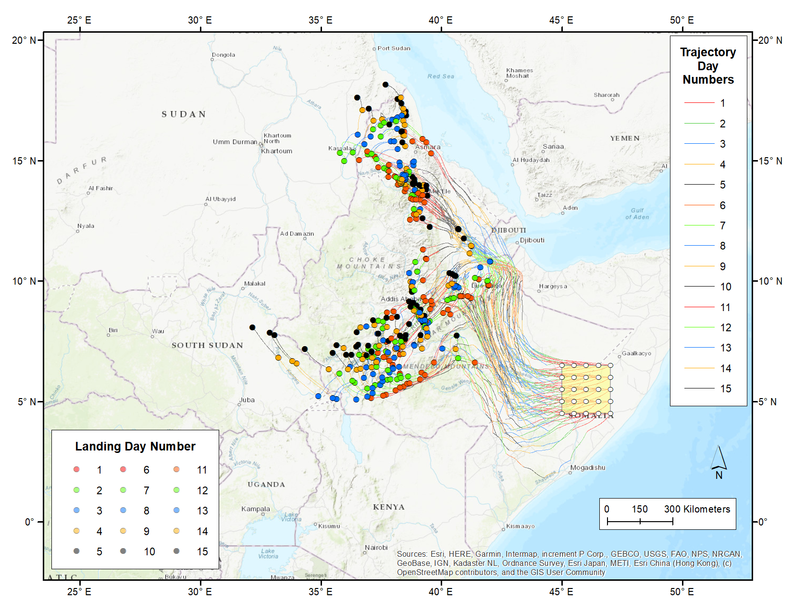
GIS Processing: Selecting / displaying landing points for a certain set of forecast days (in ArcGIS)
Here is the collection of landing points and associated trajectories for days 11 through 15.

Slide 35
Other folders with trajectory shapefiles

Slide 36
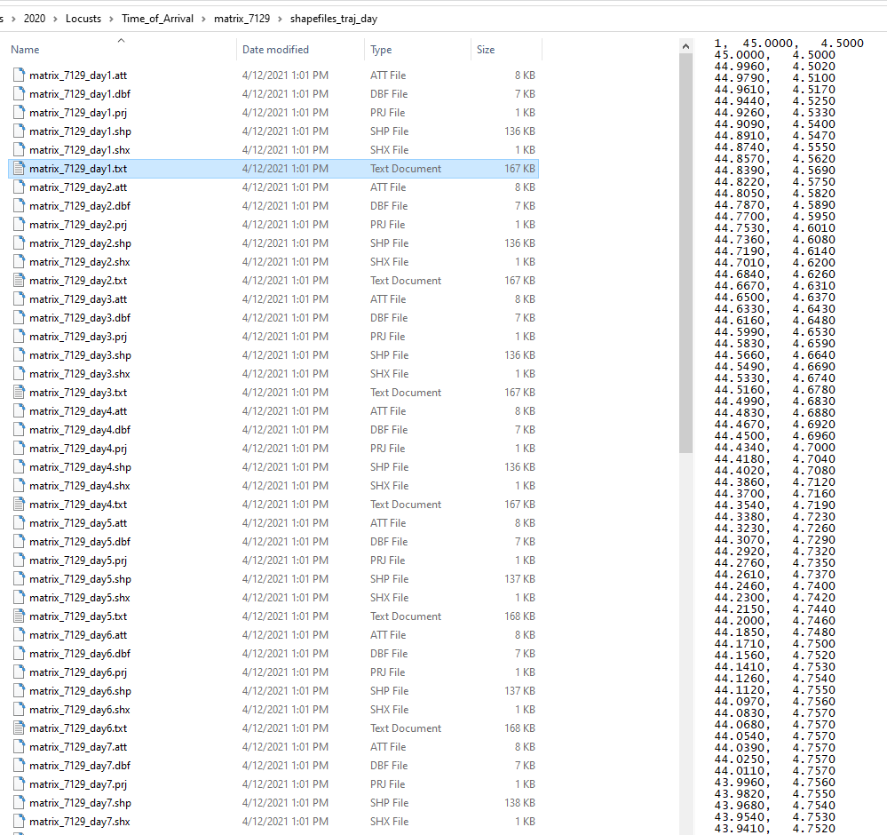

Slide 37
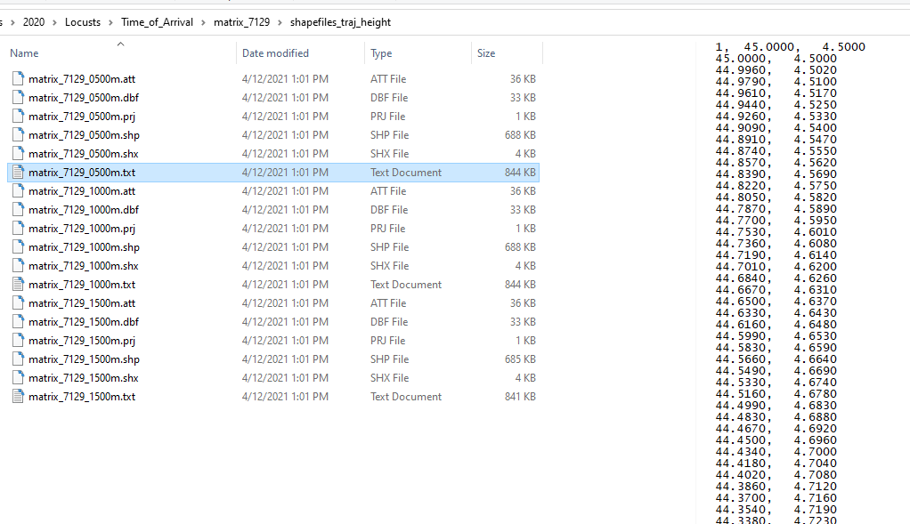

Slide 38
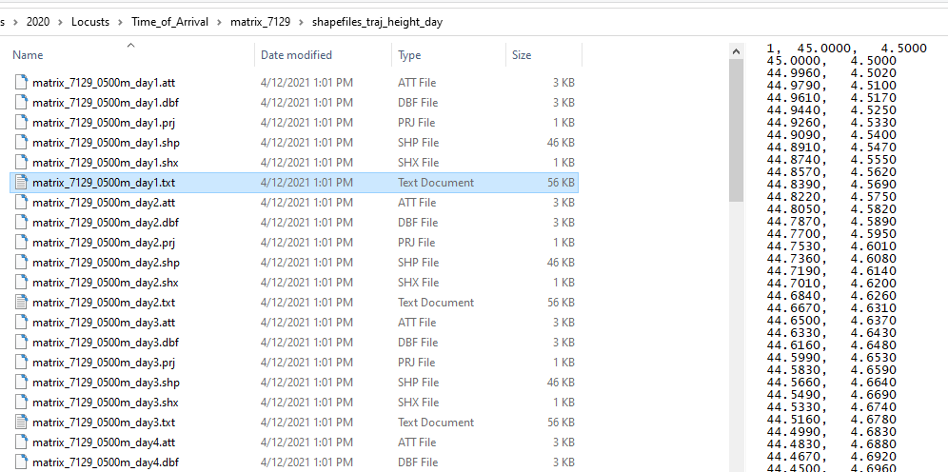

Slide 39
Trajectory Frequencies

Slide 40
Files generated in this example, once zipped “redistribution” file is unzipped
Folder with HYSPLIT Control and other model-specific files.
Folders with shapefiles associated with time of arrival (toa), trajectories, and trajectory frequencies. These can be imported into GIS applications (e.g. ArcGIS) and displayed – and processed further – according to the user’s needs
Trajectory frequency graphics
Summary files of inputs and outputs
Trajectory frequency graphics via gridplot – a different HYSPLIT mapping program
Time of Arrival graphics
Trajectory graphics

Slide 41
Graphic output of trajectory frequency information using basic HYSPLIT graphics
This is generated by the App. For more advanced modifications, user can import shape files provided in output (see additional description of this functionality below)
The source locations are shown with a matrix of stars
A grid-size is defined during specifications of the run – in this example, it was 1 deg, and this is shown in the text in the bottom panel of the graphic – and then the trajectory waypoints (every 5 minutes) are summed up on this grid. The contours shown are the waypoints for each grid square expressed as the percent of waypoint in the grid square with the maximum number of waypoints.
This graphic does not tell you anything about the time of arrival, but, does show you the overall geographical pattern of the forecasted migration from the specified source region over the forecast period.

Slide 42
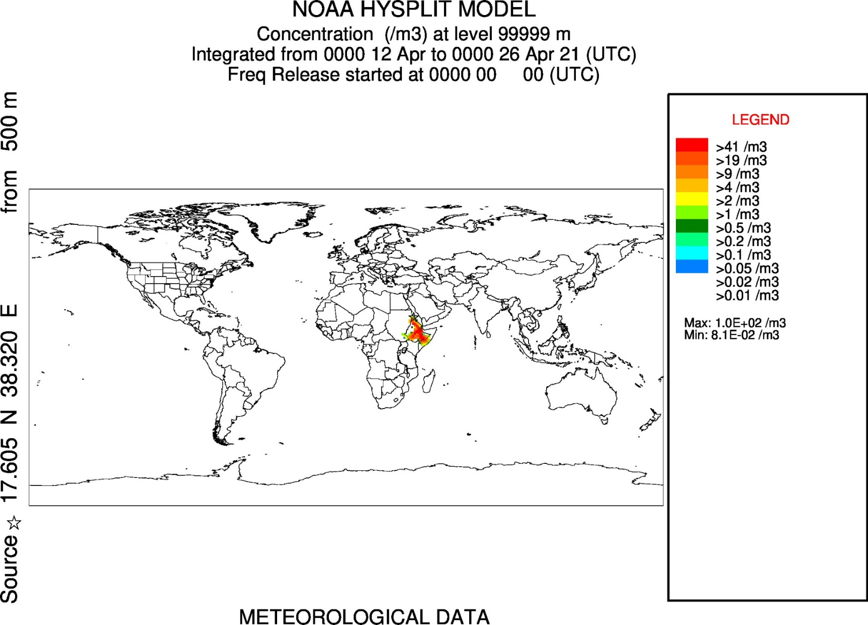
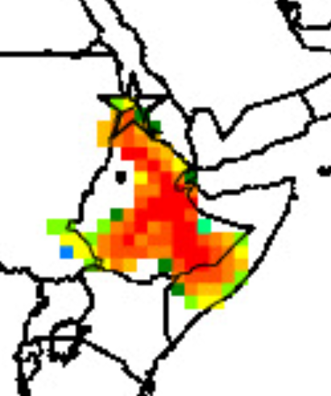
HYSPLIT has a mapping program called “gridplot” :
the Locust Migration Application also creates a trajectory frequency map using this mapping program. Here is the output for this example (matrix_7129_gridplot.jpg)
Gridplot is not optimized for plotting multiple source locations:
the “source” location is not shown correctly on the map – nor is a matrix of locations shown, which is the case in this matrix functionality – and it is not listed correctly in the text label on the left of the map.
Gridplot is not optimized for plotting frequencies:
the “units” shown are not correct. The values are the waypoint numbers for each grid cell, expressed as a percentage of the number of waypoints in the cell with the maximum number of waypoints. The units are not per cubic meters.

Slide 43
Files generated in this example, once zipped “redistribution” file is unzipped
Folder with HYSPLIT Control and other model-specific files.
Folders with shapefiles associated with time of arrival (toa), trajectories, and trajectory frequencies. These can be imported into GIS applications (e.g. ArcGIS) and displayed – and processed further – according to the user’s needs
Trajectory frequency graphics
Summary files of inputs and outputs
Trajectory frequency graphics via gridplot – a different HYSPLIT mapping program
Time of Arrival graphics
Trajectory graphics

Slide 44
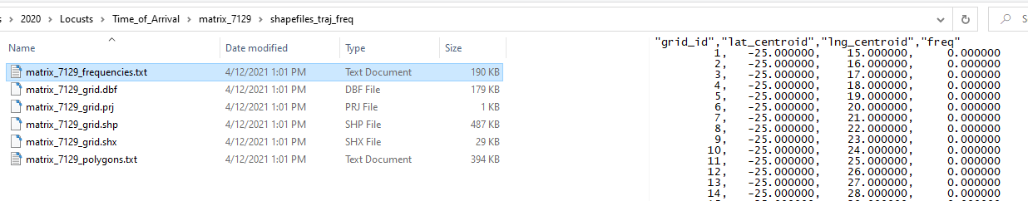
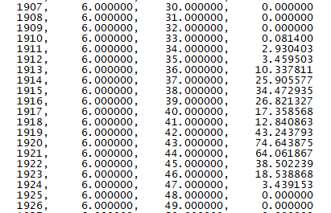
Folder: shapefiles_traj_freq
Has a shapefile – in this example: matrix_7129_grid.shp -- that can be imported into GIS applications, and also has a text file that can be imported into Excel or other data processing applications.
The “freq” field in the text file and in the shapefile is the number of trajectory waypoints in each grid cell, normalized by the maximum number of waypoints in any grid cell. The values are “percentages of the maximum”, so a frequency value of 30 means that that grid cell has 30% of the waypoints as the cell that has the maximum number of waypoints.

Slide 45
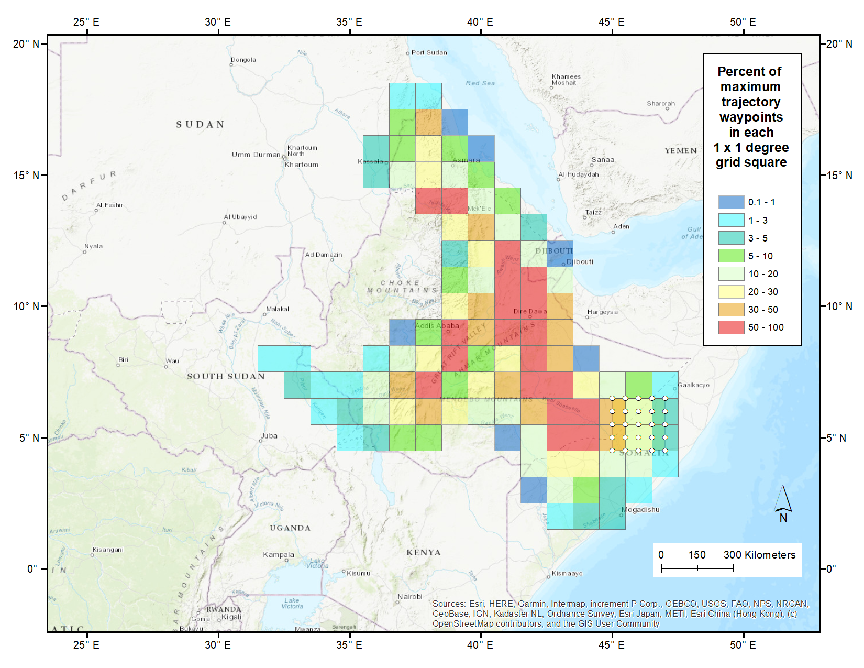
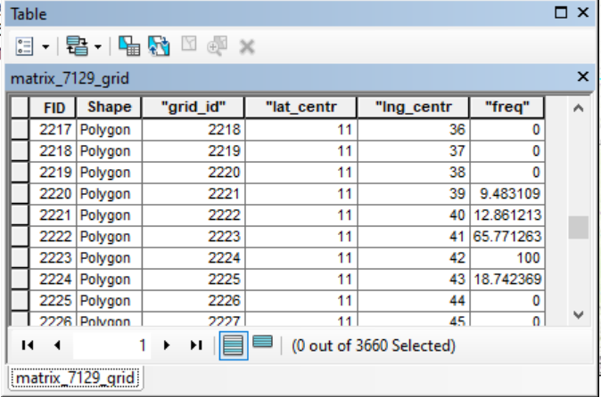
This shapefile can be imported into a GIS application and mapped. The “freq” field can be used to color the grid squares according to a user preferences.
Source locations in this example: matrix_7129_src_locs.shp

Slide 46
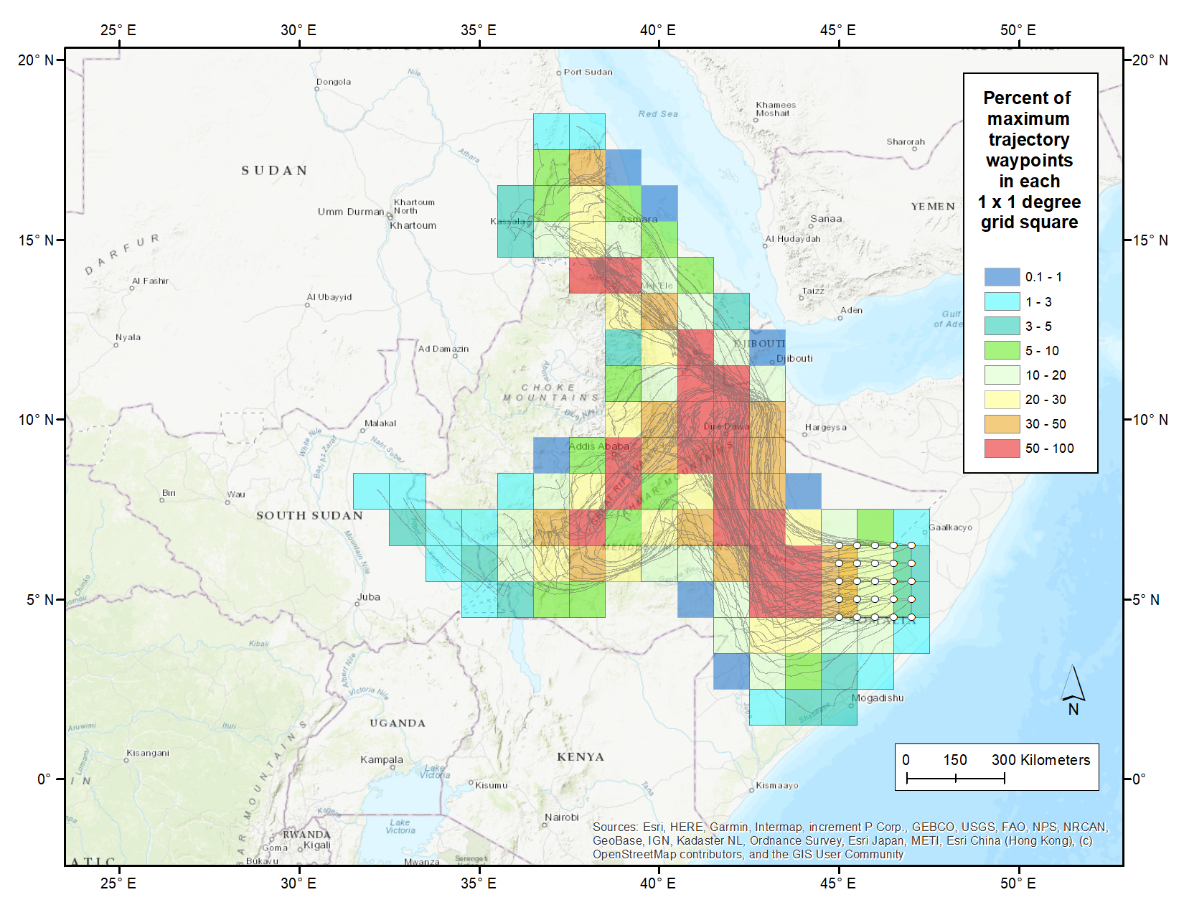
Here is the same image, but including all of the trajectory migration paths.
Source locations in this example: matrix_7129_src_locs.shp

Slide 47
HYSPLIT Folder

Slide 48
Files generated in this example, once zipped “redistribution” file is unzipped
Folder with HYSPLIT Control and other model-specific files.
Folders with shapefiles associated with time of arrival (toa), trajectories, and trajectory frequencies. These can be imported into GIS applications (e.g. ArcGIS) and displayed – and processed further – according to the user’s needs
Trajectory frequency graphics
Summary files of inputs and outputs
Trajectory frequency graphics via gridplot – a different HYSPLIT mapping program
Time of Arrival graphics
Trajectory graphics

Slide 49
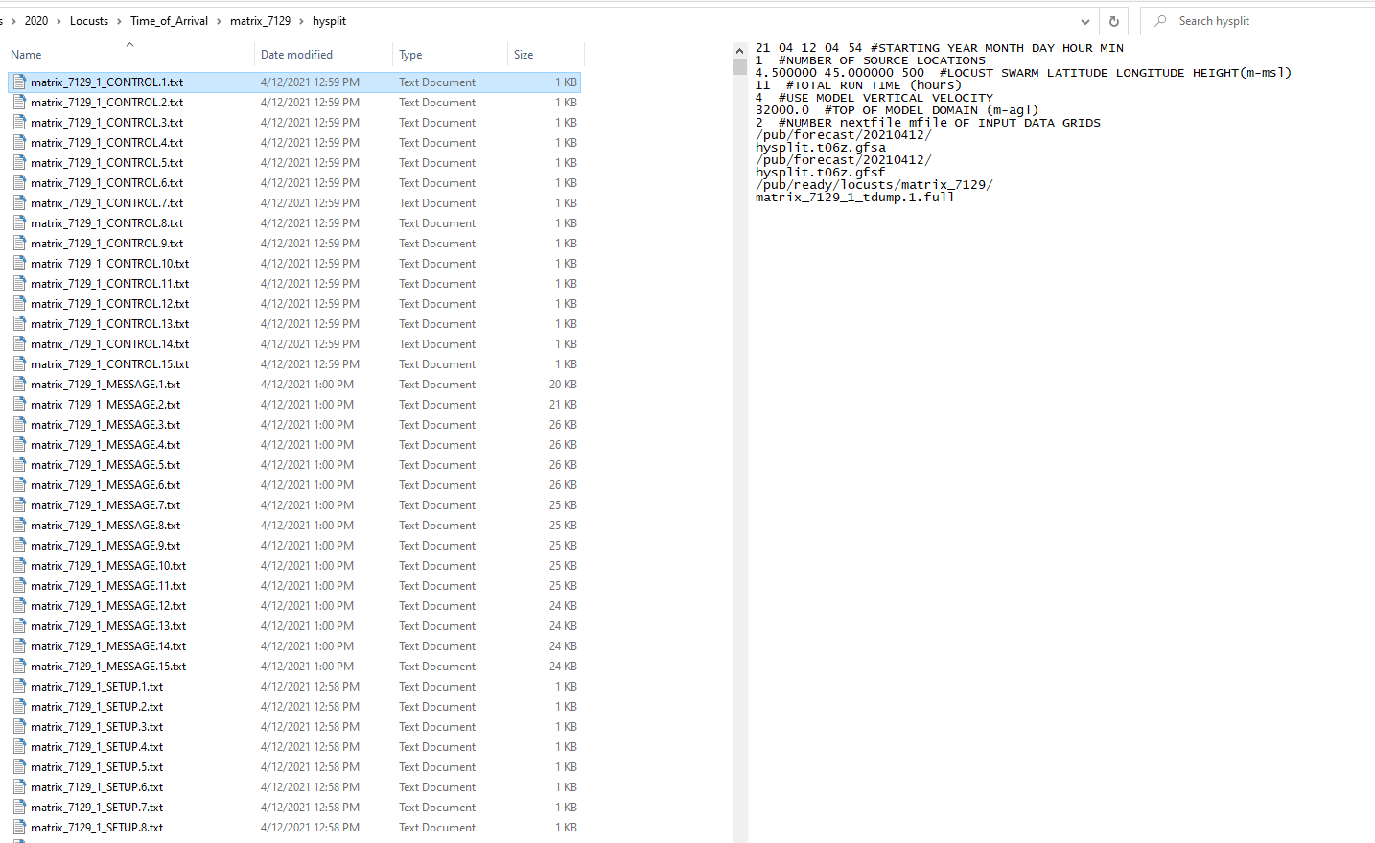
Folder with HYSPLIT Control, Message, and Setup files.
In this example, there are 25 source locations and three flying heights, so there are 75 migration paths. And for each path, there are 15 days of flights. Each flight day for each path has its own trajectory. So, there are 75 x 15 = 1125 trajectories. For each trajectory, there are the following files:
Name of file in this example for Job Name “Matrix_7129” for migration path number 5 (of 75 total), day number 14 (of 15 total) | HYSPLIT generic file name | notes
Matrix_7129_5_CONTROL.14.txt | CONTROL | The basic HYSPLIT input file for the run
Matrix_7129_5_SETUP.14.txt | SETUP.CFG | This file is another HYSPLIT input file with special settings
Matrix_7129_5_MESSAGE.14.txt | MESSAGE | A run-time file created during the simulation with diagnostic outputs (can be helpful for troubleshooting)
Matrix_7129_5_WARNING.14.txt | WARNING | A run-time file created during the simulation with warning outputs (can be helpful for troubleshooting)
Matrix_7129_5_tdump.14 | TDUMP | The “trajectory dump” file with latitude, longitude and elevation data every five minutes for the entire day’s flight
Matrix_7129_5_tdump.14.full | TDUMP | The trajectory is run longer than necessary, but then truncated based on the specified landing time. This is the tdump file before truncation.

